Slide 1
Deep Reinforcement Learning for Lunar Landing
By:
Samarth Sharma
Saipraneeth Konuri
Justin Cho

Slide 2
Introduction
Why Lunar Landing?
Challenges:
- Complex control problem with real-world applications
- Requires precise decision-making in continuous state space
- Balance between multiple objectives: speed, fuel, positioning
Real-world Applications:
- Spacecraft landing systems
- Drone navigation and control
- Robotics and autonomous systems
- Vertical takeoff and landing (VTOL) vehicles

Slide 3
State Space
The environment's state is represented by an 8-dimensional vector encompassing:
Position:
x: Horizontal coordinate.
y: Vertical coordinate.
Velocity:
x_dot: Horizontal velocity.
y_dot: Vertical velocity.
Orientation:
theta: Angle of the lander's orientation.
Angular Velocity:
theta_dot: Rate of change of the lander's angle.
Leg Contact Indicators:
leg_contact_left: Boolean indicating if the left leg is in contact with the ground.
leg_contact_right: Boolean indicating if the right leg is in contact with the ground.

Slide 4
Action Space
The environment offers a discrete action space with four possible actions:
Do Nothing: No engine activation.
Fire Left Orientation Engine: Applies torque to rotate the lander clockwise.
Fire Main Engine: Provides an upward thrust to counteract gravity.
Fire Right Orientation Engine: Applies torque to rotate the lander counterclockwise

Slide 5
Reward Structure
Proximity to Landing Pad:
Rewards increase as the lander approaches the landing pad and decrease as it moves away.
Velocity Control:
Lower velocities yield higher rewards, encouraging gentle landings.
Orientation Stability:
Maintaining a horizontal orientation is rewarded, while tilting incurs penalties.
Leg Contact:
Each leg touching the ground adds +10 points.
Fuel Consumption:
Main engine usage costs -0.3 points per frame.
Side engine usage costs -0.03 points per frame.
Episode Outcomes:
Safe Landing: +100 points.
Crash: -100 points.
An episode is considered solved with a score of 200 points or more.

Slide 6
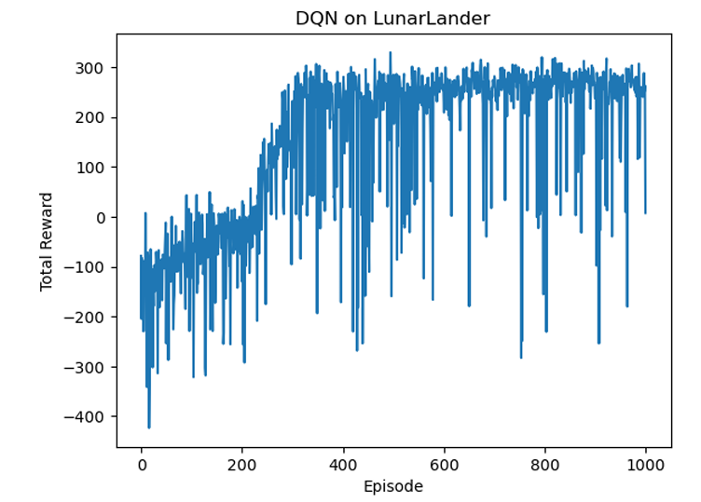
DQN algorithm demonstrates the capability to learn an effective policy for Lunar Lander, with a clear improvement in rewards over time. However, persistent instability and variability in rewards, along with occasional crashes, point to areas for further refinement,

Slide 7
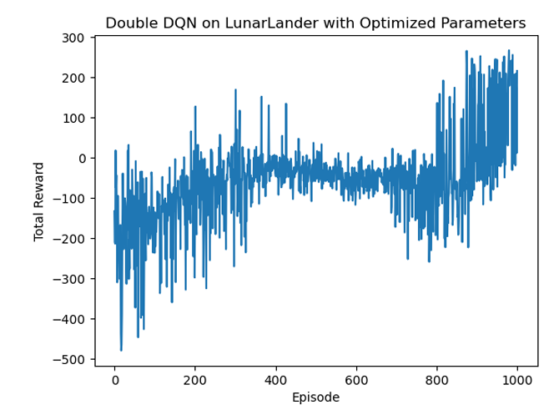
Our findings indicate that while Double DQN offers theoretical advantages in reducing overestimation bias, DQN consistently outperformed it in terms of average rewards, stability, and convergence speed under the tested conditions.

Slide 8
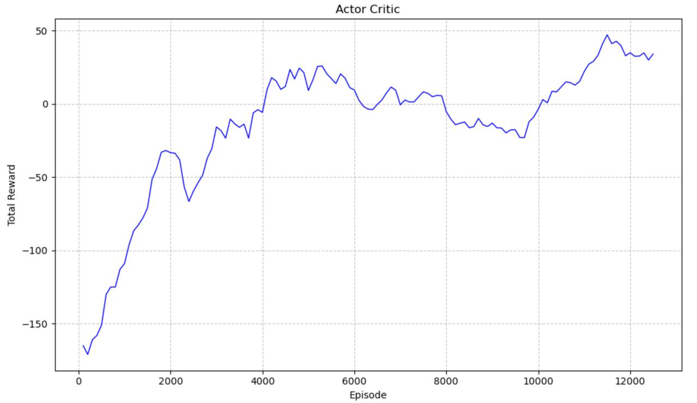
While A2C showed moderate learning, it was clearly outperformed by DQN in this environment. The slower progress and lower rewards suggest A2C struggled with the discrete action space, environmental variability, and delayed reward structure.

Slide 9
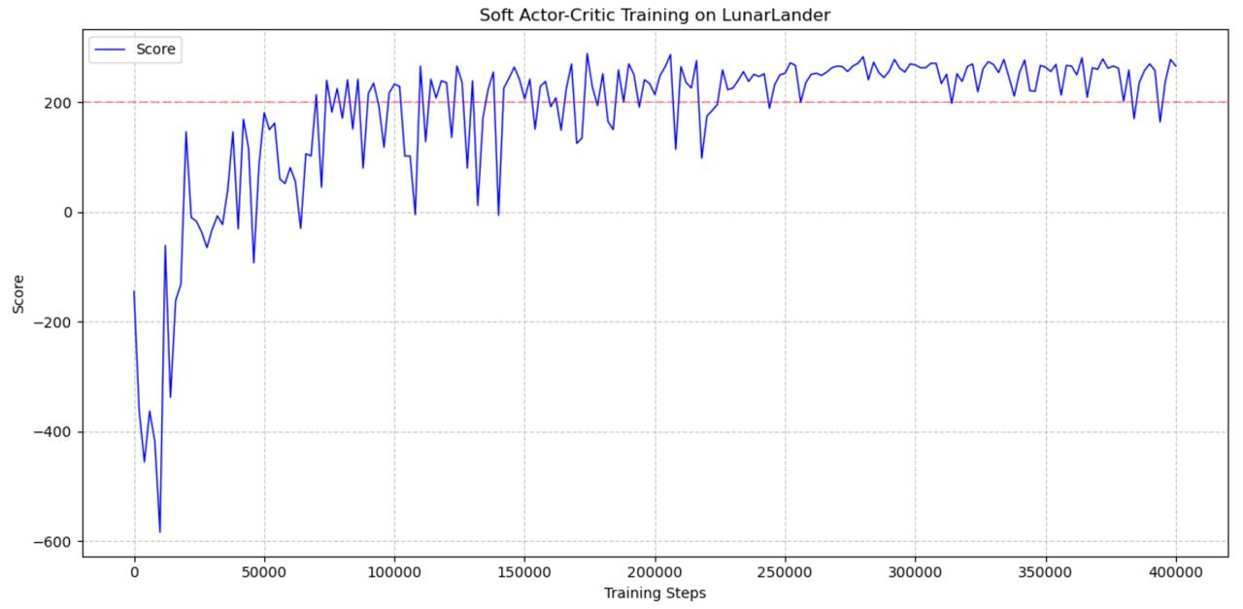
The Soft Actor-Critic (SAC) algorithm demonstrates superior performance compared to DQN, Double DQN, and Actor-Critic on the LunarLander-v2 environment. It learns much faster, shows greater consistency in its performance, and achieves considerably higher average rewards

Slide 10
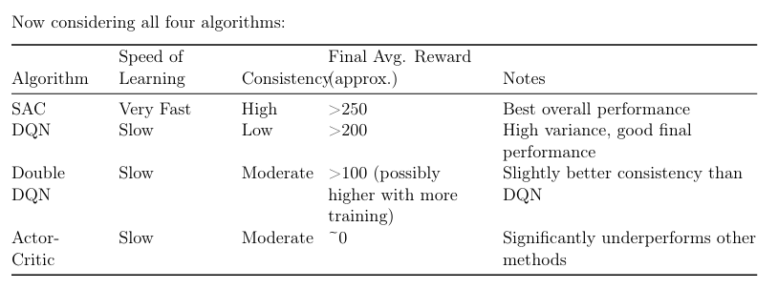

Slide 11
Conclusion
Soft Actor-Critic (SAC) emerged as the clear winner, showing several key advantages:
Faster Learning: Reached positive rewards within 20-30k steps
Better Stability: Maintained consistent performance with less variance
Higher Performance: Achieved and maintained scores above 250
Efficient Exploration: The adaptive alpha parameter successfully balanced exploration and exploitation
The value-based methods (DQN and Double DQN) eventually achieved good performance but had notable limitations:
Required longer training time to reach positive rewards
Showed higher variance in performance
Never quite matched SAC's consistency or peak performance
The Actor-Critic implementation performed poorest among all tested algorithms, struggling to maintain positive rewards even after extensive training.

Slide 12
Thank You

